Slide 1
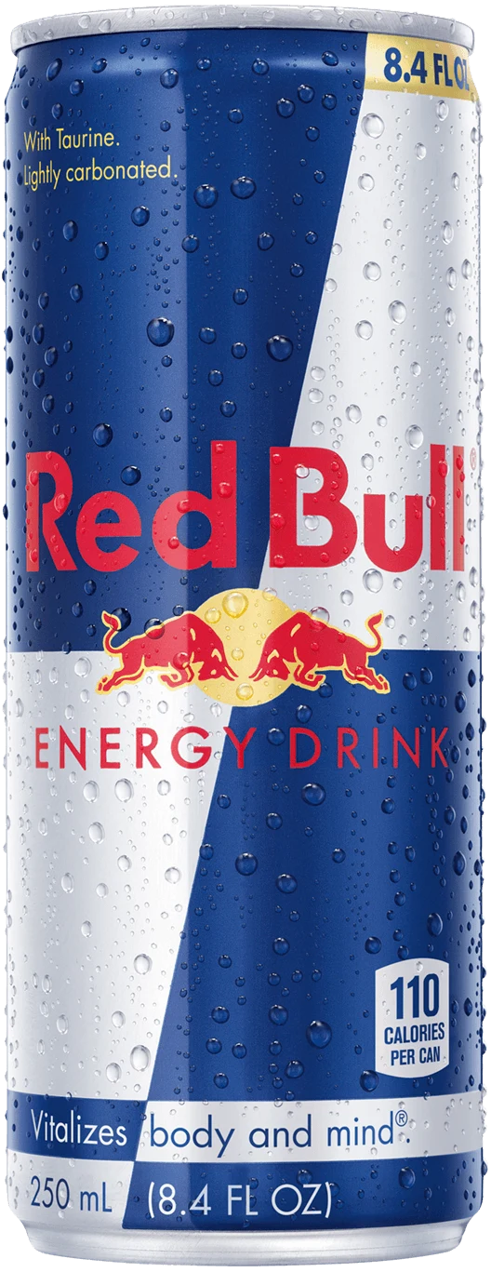
EMERCo Red Bull Insights
INSIGHTS AND RECOMMENDATIONS

Slide 2
Margin and Problem Related Concern
RB Varieties (#) | Average of RB Margin %
3 | 36.51%
4 | 35.10%
1 | 34.93%
The Top 3 Products that help the bottom line of Red bull are RB variety 3,4 and 1
These three Product contributes highest Red Bull Sales, $144K, $112K, $93K Respectively And they have very high higher margin compare to other variety of red bull variety.

Slide 3
Recommendations
Prioritize High-Margin Products (RB Variety 3, 4, and 1): Focus on promoting and expanding these varieties as they significantly contribute to both sales and profitability.
Reevaluate Low-Margin Products (RB Variety 2, 5, and 6): Consider cost optimization, price adjustments, or bundling strategies to improve margins for these varieties without compromising sales volume.
Monitor and Strategize for Non-Performing Variety (RB Variety 0): Investigate why this variety has no sales or margins and decide whether to relaunch with improvements, discontinue, or reposition it strategically.

Slide 4
Red Bull ColaCo Coolers Sales and Margin Comparison
Sales Performance:
Top Cooler: Cooler #4 generates the highest sales ($12,398) out of a total of $79,897.
Underperformance: Coolers #0 and #7 are significantly underutilized, with $0 and $2,675 in sales, respectively.
Profitability:
Red Bull has consistently high margins (32.85%–37.82%), with most coolers operating above 35%.
Profitability per unit is strong compared to competitors, despite lower total sales.
Cooler Utilization:
Several coolers are not optimally placed or underperforming, reducing overall efficiency.
ColaCo leads in total sales due to better cooler utilization and placement.

Slide 5
Precise Recommendations
Optimize Cooler Placement:
Relocate underperforming coolers (e.g., #0 and #7) to high-traffic areas with proven demand.
Study and replicate the successful strategies of top coolers (e.g., #4, #2, and #5) in terms of location and marketing.
Leverage High Margins:
Introduce volume-based discounts or combo offers to capitalize on Red Bull’s 35%–37% margins while increasing sales.
Use high margins to incentivize retail partners to improve cooler placements.
Expand Strategically:
Deploy additional coolers in untapped markets or ColaCo’s low-performing areas to grow sales while maintaining margins.
Prioritize high-potential locations for expansion based on historical data.
Data-Driven Monitoring:
Continuously track cooler performance and sales data to dynamically adjust inventory, marketing, and placement strategies.
Use data insights to identify emerging market opportunities and allocate resources effectively.

Slide 6
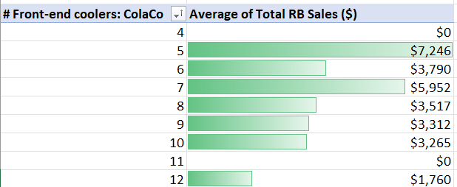
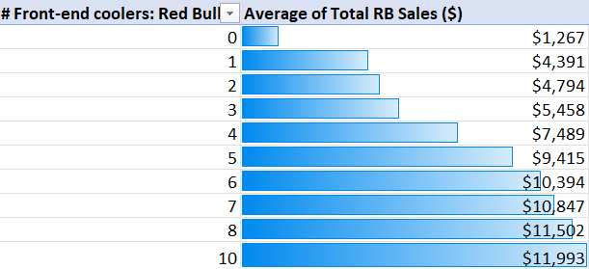
Should we Change ColaCo Coolers with Red bull Coolers?
Insights:
Sales Comparison:
ColaCo Coolers: Lower sales across all ranges; highest average sales at $7,246 (5 coolers).
Red Bull Coolers: Superior sales, with a peak average of $11,993 (10 coolers).
Sales Trends:
ColaCo Coolers: No consistent relationship between the number of coolers and sales; lacks correlation.
Red Bull Coolers: Strong upward trend; more coolers directly correlate with higher sales.
Zero-Sales Occurrences:
ColaCo Coolers: Instances of $0 sales (e.g., 4 and 11 coolers), signaling inefficiencies or low demand.
Red Bull Coolers: No zero-sales occurrences, reflecting reliable performance.
.

Slide 7
Precise Recommendations
Recommendations:
Replace ColaCo Coolers with Red Bull Coolers to optimize sales and revenue, leveraging:
Higher average sales.
Positive sales trend with cooler count.
Consistent performance without $0 sales.

Slide 8
Thank you

